Slide 1

A Project Report on “MESS MANAGEMENT SYSTEM” SUBMITTED BY: Tejas Bhagawat
SUBJECT
C++
PROGRAMMING
Under the Guidance of
Ms. Ishawari Tirse
Ma’am
Department of
Computer Science and Engineering
Sanjivani Rural Education Society’s
SANJIVANI UNIVERSITY
KOPARGAON – 423603,
DIST : AHMEDNAGAR 2024-2025

Slide 2
INDEX
.
SR. NO. | CONTENT | PAGE NO.
1. | INTRODUCTION | 3
2. | CODE | 4
3. | OUTPUT | 11
4. | CONCLUSION | 14

Slide 3
INTRODUCTION
A Mess Management System is a software application that helps manage the daily operations of a Mess.itle: C++ Mess Management SystemThe Mess Management System is a computerized application designed to streamline and automate the management of a mess or cafeteria. This system aims to provide an efficient and user-friendly platform for managing daily activities such as food ordering, inventory management, billing, and reporting. Developed using C++, this system will reduce manual errors, enhance productivity, and improve overall customer satisfaction.There are many benefits of a c++-based Mess Management System

Slide 4
CODE
#include <iostream>
#include <string>
using namespace std;
class Student
{
public:
string name;
string mobile_Number;
string college_Name;
string college_Address;
int roll_Number;
string hostel_Address;
void getDetails()
{
cout << "Enter student's name: ";
getline(cin, name);
cout << "Enter student's mobile number: ";
getline(cin, mobileNumber);
cout << "Enter student's college name: ";
getline(cin, collegeName);
cout << "Enter student's college address: ";
getline(cin, collegeAddress);
cout << "Enter student's roll number: ";
cin >> rollNumber;
cin.ignore();
cout << "Enter student's hostel address: ";
getline(cin, hostelAddress);
}

Slide 5
void displayDetails() { cout << "\nStudent's Information: " << endl; cout << "Name: " << name << endl; cout << "Mobile Number: " << mobileNumber << endl; cout << "College Name: " << collegeName << endl; cout << "College Address: " << collegeAddress << endl; cout << "Roll Number: " << rollNumber << endl; cout << "Hostel Address: " << hostelAddress << endl; } }; void displayMenu(string menu[], int price[], int size) { cout << "\nMenu:\n"; for (int i = 0; i < size; i++ ) { cout << i+1 << ". " << menu[i] << " - Rs." << price[i] << endl; } } int main() { Student s; s.getDetails(); s.displayDetails(); string menu[10] = { "Daal-Roti", "Plain Rice", "Jeera-Rice", "Veg-Thali", "Non-Veg Thali", "Regular Sabzi Roti", "Curry Rice", "Any Paneer Sabzi", "Sweet Dish", "Extra Roti" }; int price[10] = { 75, 25, 30, 120, 150, 199, 80, 100, 50, 10 }; displayMenu(menu, price, 10); int choice, quantity; char anotherOrder; int totalCost = 0;

Slide 6
do { cout << "\nEnter the item number you want to order: "; 1 cin >> choice; if (choice > 0 && choice <= 10) { cout << "Enter the quantity for " << menu[choice - 1] << ": "; cin >> quantity; totalCost += price[choice - 1] * quantity; cout << "Added to your order!\n"; } else { cout << "Invalid choice! Please select from the menu.\n"; } cout << "Do you want to order another item? (y/n): "; cin >> anotherOrder; } while (anotherOrder == 'y' || anotherOrder == 'Y’); cout << "\nTotal cost of your order: Rs." << totalCost << endl; return 0; }

Slide 7
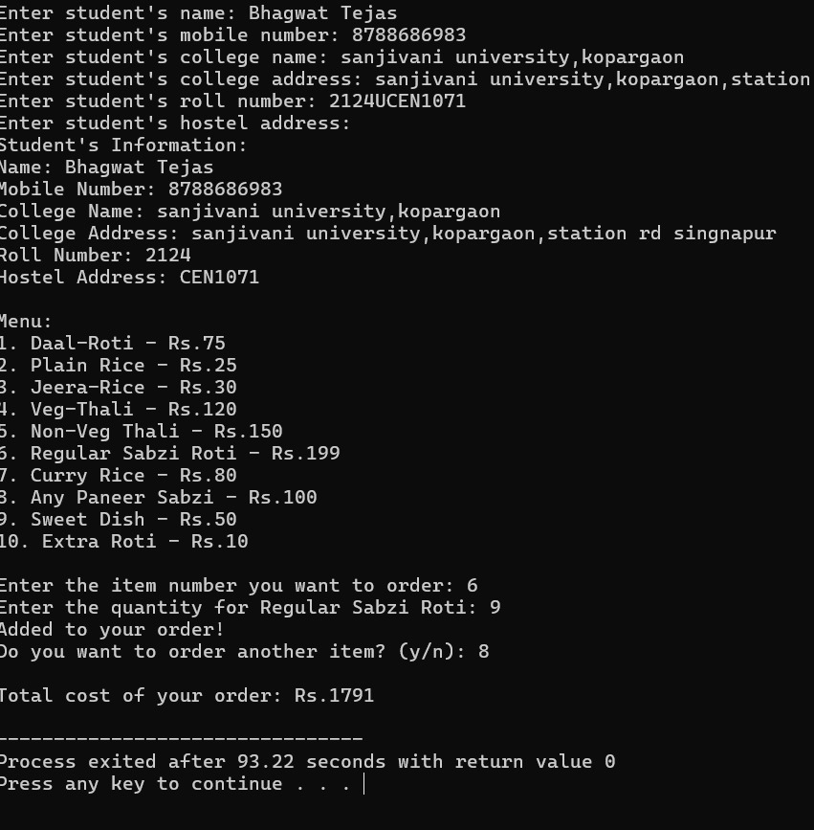
OUTPUT

Slide 8
CONCLUSION
The C++ Mess Management System successfully demonstrates a comprehensive and efficient solution for managing mess operations. Key benefits of this system include: Improved accuracy and reduced manual errors. Enhanced customer satisfaction through streamlined ordering and billing. Increased productivity for mess staff. Real-time reporting and analytics for informed decision-making.There are many benefits of a c++-based Mess Management System

